Slide 1
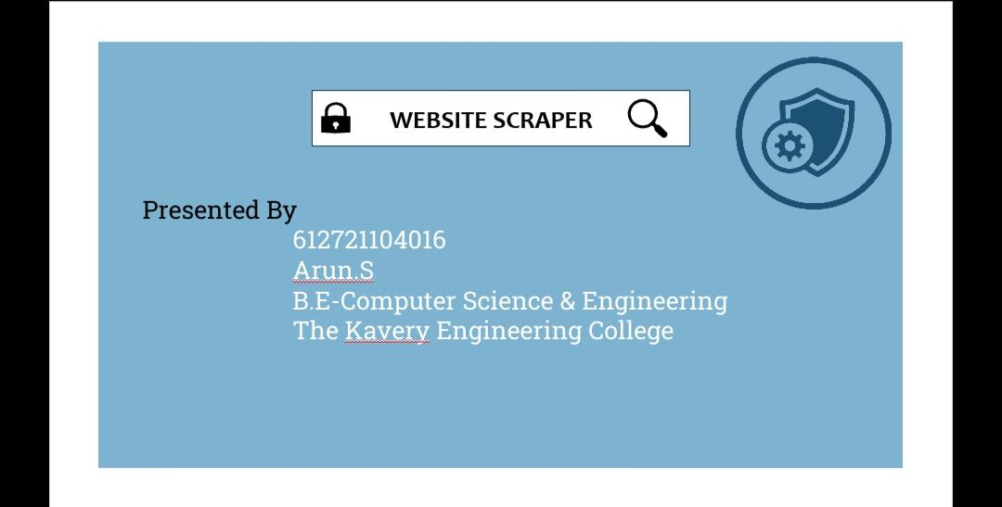

Slide 2
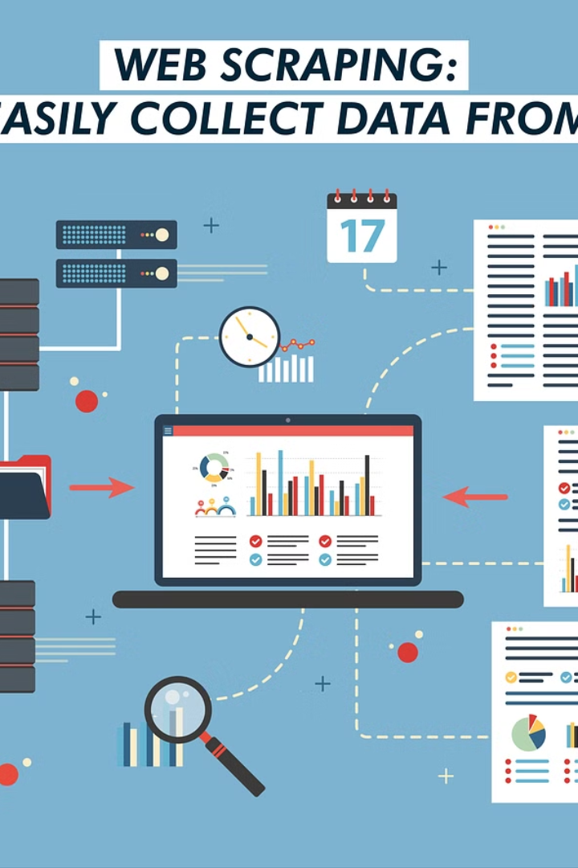
Introduction to Website Scraping
Website scraping, also known as web harvesting or web data extraction, is the process of extracting data from websites. This could be done manually by a person or automatically using a bot. Website scraping can be used in a variety of ways, such as price monitoring, data collection, and research. It involves accessing the web page's HTML and then extracting the data you need. Additionally, it can provide valuable insights and help make informed decisions.

Slide 3
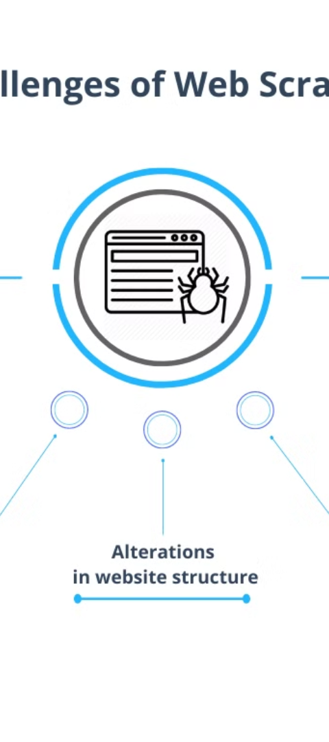

Problem Statement
1
Data Gathering
One of the key challenges in web scraping is gathering the right data in an ethical and legal manner. This involves understanding the website's terms of service, respecting robots.txt, and avoiding overloading the site's servers.
2
Data Quality
Ensuring the accuracy and reliability of the scraped data is essential. Inconsistent data formats, incomplete information, and changes in website structure can pose significant obstacles in obtaining high-quality data.
3
Avoiding Detection
Many websites implement measures to prevent scraping, such as CAPTCHA challenges, IP blocking, and honeypot traps. Overcoming these obstacles while being respectful of the website's policies can be a significant challenge.

Slide 4
System Development Approach
Target Identification
Tool Selection
Data Management
The first step in developing a website scraping system is to clearly identify the target websites and the specific data that needs to be extracted. It's important to understand the structure and content of the websites to ensure effective data extraction.
Choosing the right tools is crucial in building an efficient web scraping system. This includes selecting appropriate libraries, frameworks, and programming languages that align with the project requirements.
Efficient data storage, processing, and maintenance are key considerations in the system development process. Developing a robust data management approach ensures that the extracted data is organized and accessible for analysis and application.

Slide 5

Algorithm & Deployment
1
Algorithm Design
2
Scalable Deployment
Designing effective algorithms for web scraping involves considering factors such as data volume, processing speed, and error handling. It requires a balance between efficiency and accuracy.
Deploying a web scraping system at scale involves addressing challenges related to resource management, scheduling, and monitoring. Scalability ensures that the system can handle increasing data volumes and user demands.
3
Ethical Considerations
Understanding and adhering to ethical guidelines in web scraping is crucial. This includes respecting website policies, user privacy, and data usage rights throughout the algorithm design and deployment process.

Slide 6
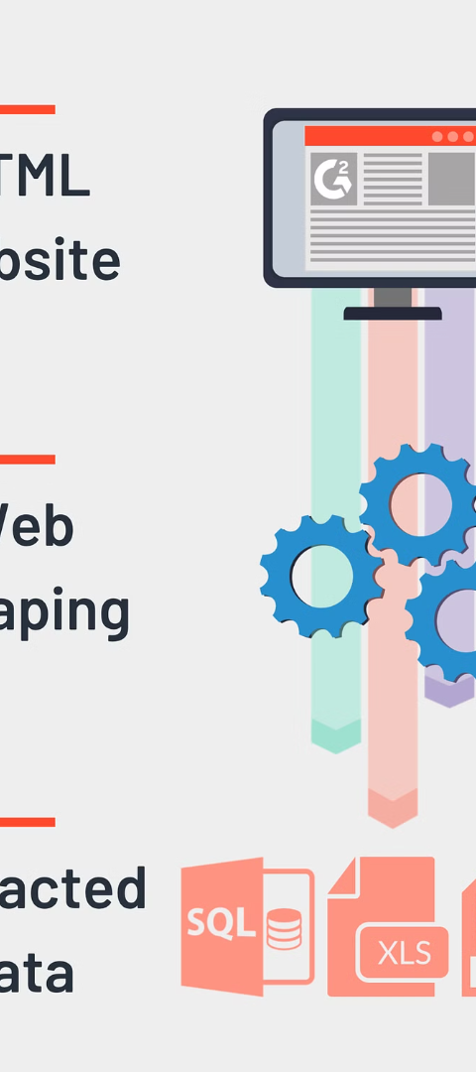



Result (Output Image)
Data Extraction
Web scraping results in the extraction of structured data from various websites to facilitate analysis and decision-making processes.
Insight Generation
The extracted data is processed to generate insights and trends that can drive strategic decisions and innovative solutions in a variety of fields.
Automation Possibilities
Web scraping facilitates the automation of data collection processes, leading to increased efficiency and the ability to track dynamic changes in real-time.

Slide 7
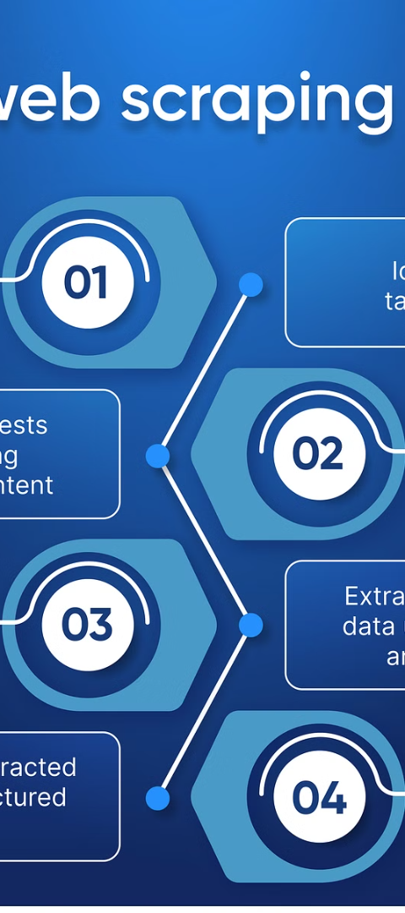
Conclusion
Data Accessibility
Challenges & Opportunities
Web scraping provides access to a wealth of data that can contribute to research, innovation, and informed decision-making across diverse domains.
The conclusion of any web scraping project involves a reflection on the challenges encountered, as well as the opportunities uncovered for future development and refinement of the process.
Ethical Framework
A critical aspect of the conclusion is the evaluation of ethical considerations and the assurance that the web scraping process has been conducted in a responsible manner.

Slide 8



Future Scope
Technological Advancements
Innovative Applications
Industry Growth
Web scraping holds the potential for innovative applications in fields such as market research, competitive analysis, and predictive modeling.
As the importance of data-driven decision-making grows, web scraping is expected to play a significant role in driving industry growth and development.
Future advancements in technology may lead to new tools and methods for more efficient and versatile web scraping processes.

Slide 9
Reference
1. Title: "Web Scraping with Python"
Author: Ryan Mitchell
2. Title: "Python Web Scraping Cookbook"
Author: Shashwat Jaidka

